Slide 1
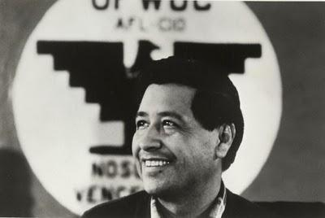
RTI at Cesar Chavez K-8
By: Cesar Hernandez
Britt Kuether
Amber Anderson

Slide 2
What is RTI?
The RTI process has three purposes:
To review school-wide behavior and academic data in order to evaluate the effectiveness of core programs.
To screen and identify students needing additional academic and/or behavior support.
To plan, implement and modify interventions for these students.
Depending on each student’s “response to intervention,” a formal referral for special education evaluation may result.
Notes:
Goals:
1. Leadership: Build leadership skills in school and district leaders for developing the infrastructure, implementation, accountability and sustainability of an RtI system.
2. Instruction: Support districts in providing high quality instruction and interventions matched to student need that raises the achievement of all students including all sub groups.
3. Data Based Decision Making: Support districts in using data based decision making as part of their on-going instructional improvement cycle.
4. LD Identification: Support districts in developing the capacity and confidence to make LD eligibility decisions that are appropriate and meaningful through the RtI process.
5. Professional Development: Support districts to develop and maintain professional development systems to support their RtI systems.
6. Assessment Systems: Support districts to develop, use, and maintain their assessment systems (screening, progress monitoring, mastery, and outcome) to improve instruction for students.

Slide 3
Response to Intervention
Vision: Every child in every district receives the instruction that they need and deserve… every day.
Mission: Cultivate the thinking and skills in leadership at all levels to build and sustain a comprehensive multi-level system of prevention and support that identifies and serves the instructional needs of all children.

Slide 4
THE RTI MODEL LOOKS AT
1. Leadership: Build leadership skills in school and district leaders for developing the infrastructure, implementation, accountability and sustainability of an RTI system.
2. Instruction: Support districts in providing high quality instruction and interventions matched to student need that raises the achievement of all students including all sub groups.
3. Data Based Decision Making: Support districts in using data based decision making as part of their on-going instructional improvement cycle.

Slide 5
RTI @ Cesar Chavez
4. LD Identification: Support districts in developing the capacity and confidence to make LD eligibility decisions that are appropriate and meaningful through the RTI process.
5. Professional Development: Support districts to develop and maintain professional development systems to support their RTI systems.
6. Assessment Systems: Support districts to develop, use, and maintain their assessment systems (screening, progress monitoring, mastery, and outcome) to improve instruction for students.

Slide 6
Why Use the RTI MODEL?
Response to Intervention is an “all education” (general, special education, etc.) framework that involves research-based instruction and interventions, regular monitoring of student progress, and the subsequent use of these data over time to make educational decisions.
RTI seeks to prevent academic failure through early intervention, frequent progress monitoring, and increasingly intensive research-based instructional interventions for children who continue to have difficulty. The key to the RTI process is the application of scientifically based instruction and interventions. A goal of the RTI process is to apply accountability to educational programs by focusing on programs that have been proven to work rather than programs that simply look, sound, or feel good. Additionally, RTI plays a critical role in how students are identified as having a disability and needing special education services.

Slide 7
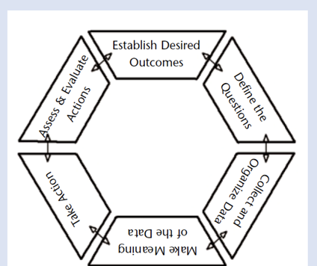
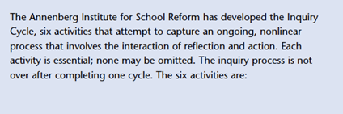
The Inquiry Cycle

Slide 8
Core Components of RTI
RTI follows a number of core components:
1. The educational system can effectively teach all children
2. Early intervention is critical to preventing problems from getting out of control
3. The implementation of a multi-tiered service delivery model is necessary
4. A problem solving model should be used to make decisions between tiers
5. Research based interventions should be implemented to the extent possible
6. Progress monitoring must be implemented to inform instruction
7. Data should drive ALL decision making by the team.

Slide 9
1st Year Blueprint
RTI Training Model
Year 1: (Installation Phase)
Year 1 in the OrRTI project focuses on building the infrastructure for your Schools’ RTI systems. This is often referred to as the Installation Stage. It is important to focus on the Installation Stage to acquire or repurpose the resources needed to do the work ahead.

Slide 10
1st Year Blueprint
During the Installation Stage, districts should select staff for key positions, identify areas and support needed for training and coaching, provide initial training for staff, and find or establish performance assessment (fidelity) tools (Fixsen et al. 2005; Saldana et al., 2012).

Slide 11
1st Year Blueprint
By planning well before implementing districts can limit set backs, increase staff confidence, and improve student outcomes more effectively.
OrRTI training and support focuses on three main areas to assist districts during the Installation Stage; these areas are listed below.

Slide 12
Areas of Focus
Leadership: focuses on understanding the key elements needed for successful implementation of a RTI system.
RTI components: focuses on developing standards of practice in the RTI components of core reading instruction, universal screening and 100% team meetings.
Professional Learning/Development: focuses on how to plan for, deliver, and support training in the RTI components in order to train and support staff at the building level.

Slide 13
Cesar Chavez K-8

Slide 14
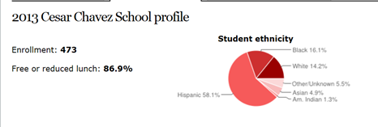
Cesar Chavez K-8

Slide 15
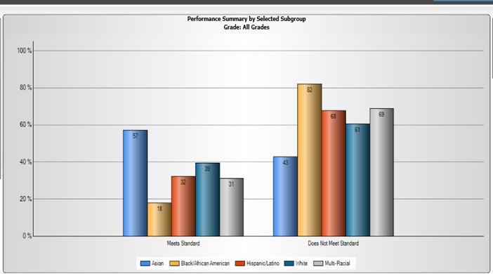
Math Scores for 2013-2014

Slide 16
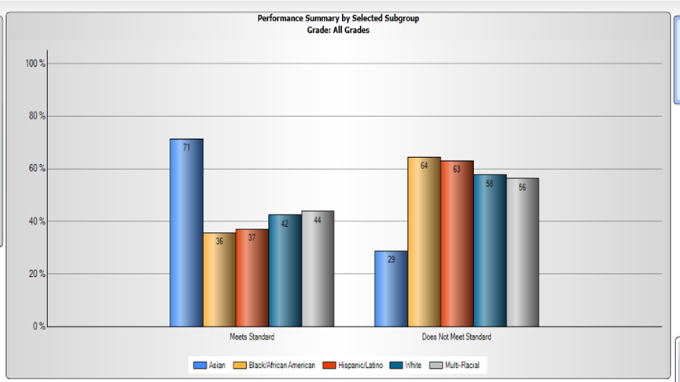
Reading Score for 2013-2014

Slide 17
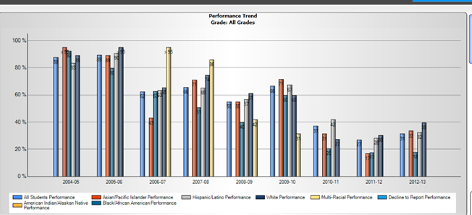
Student Performance Trend for Math

Slide 18
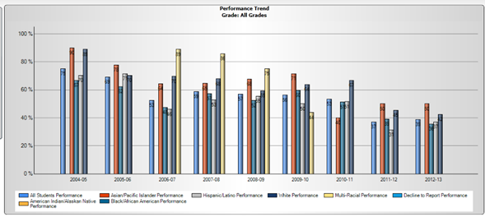
Student Performance Trend for Reading

Slide 19
Cesar Chavez CAP Plan Includes RTI
Current School Service Delivery Systems
Administrative Systems
Behavior Systems
RTI Timeline for Effective Delivery and Deployment

Slide 20
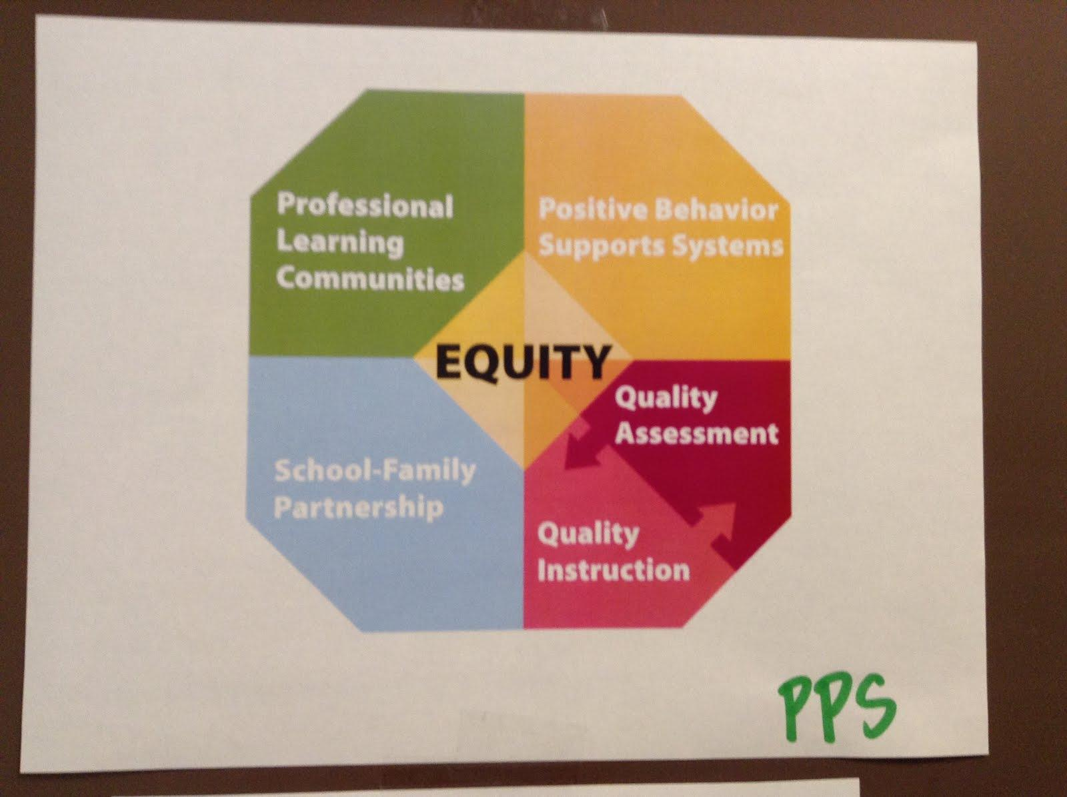
PPS Comprehensive Achievement Plan

Slide 21
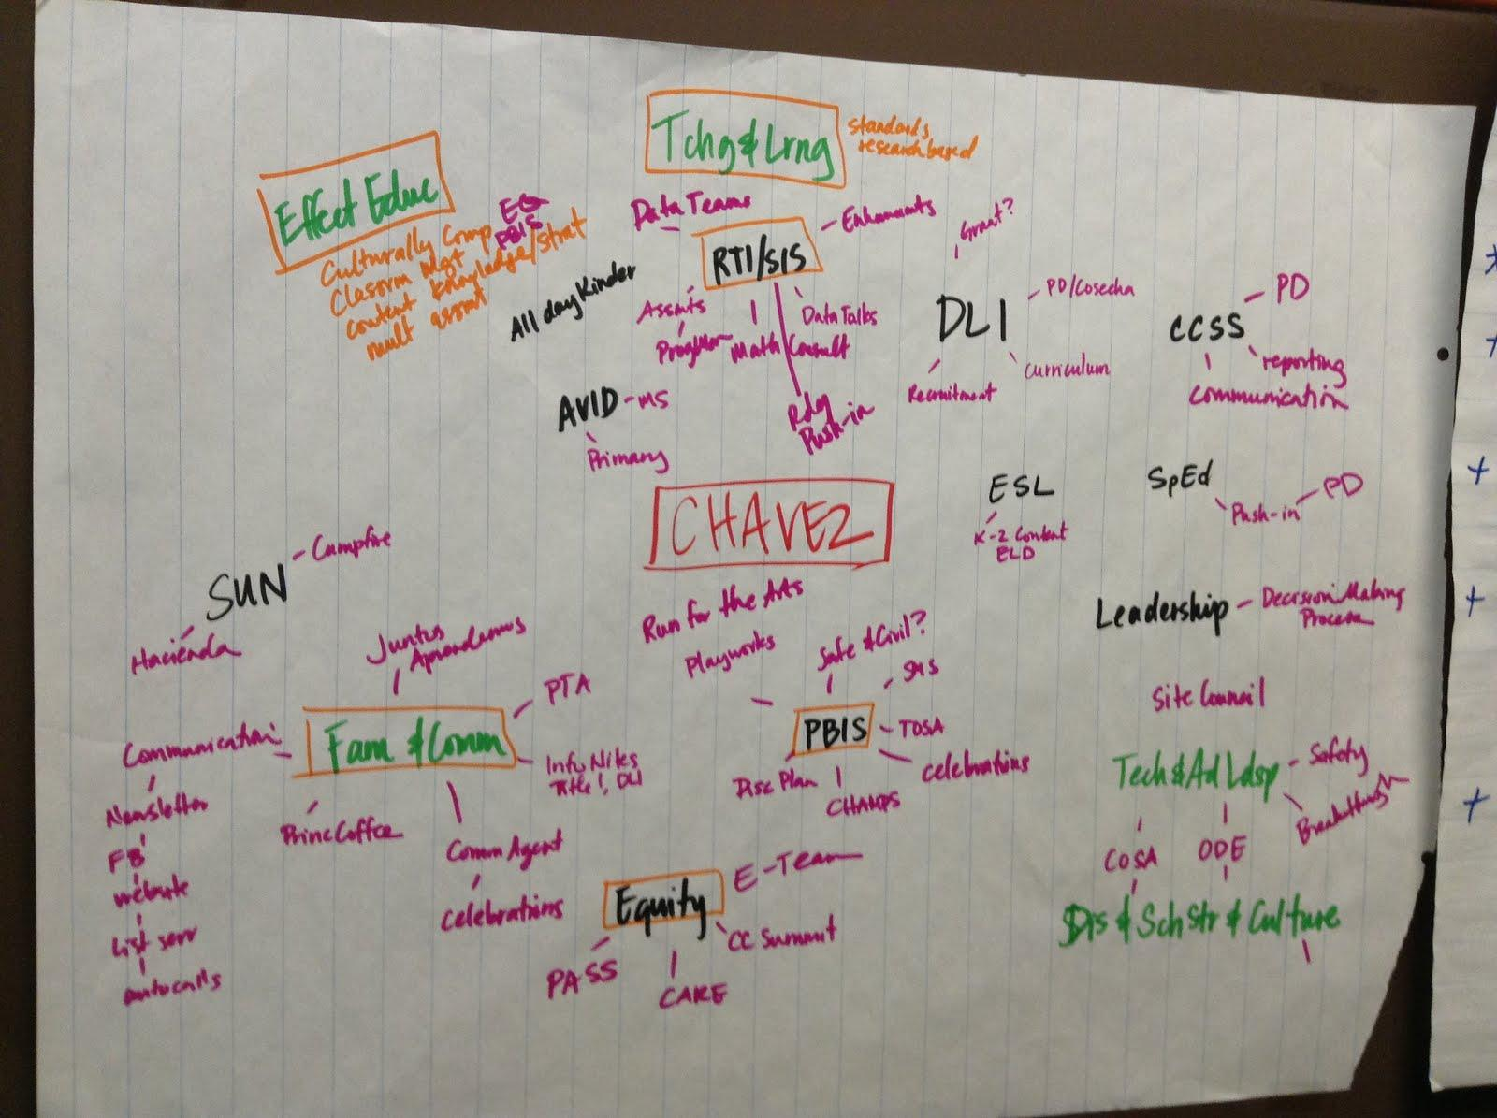

Slide 22
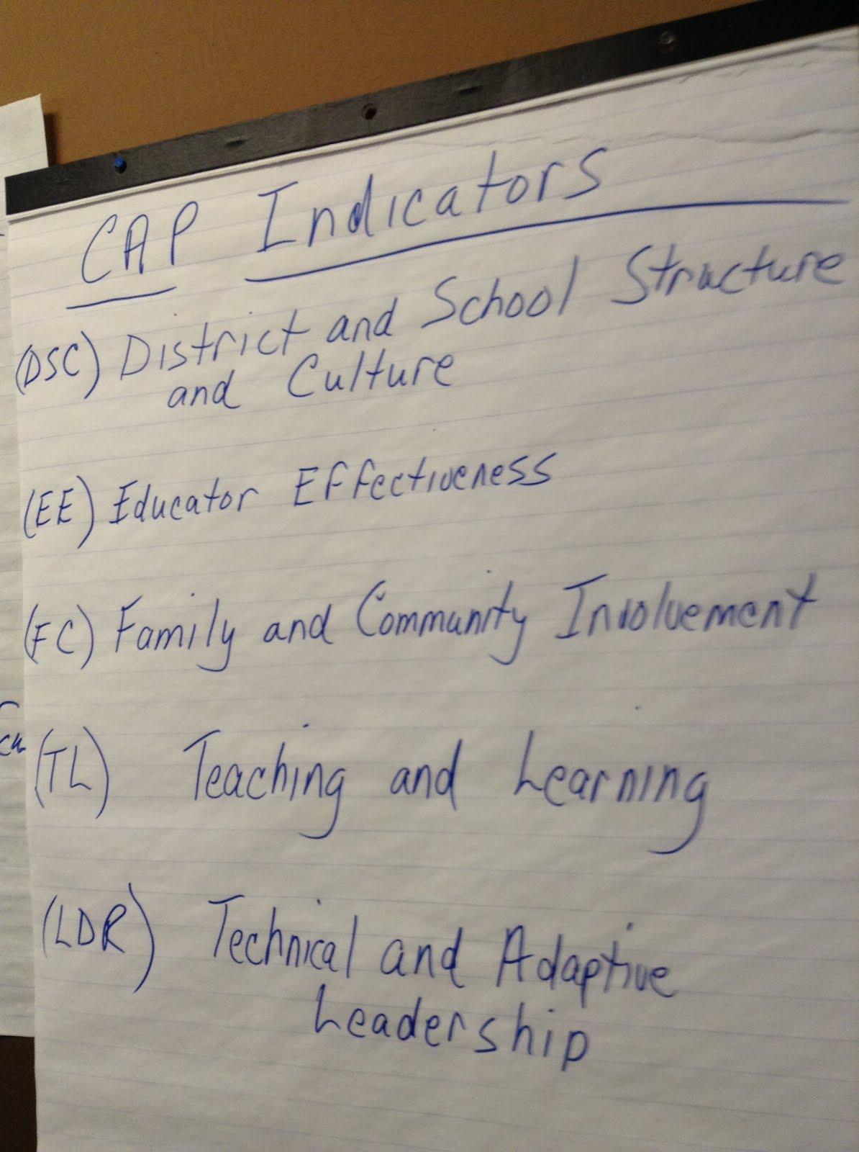

Slide 23
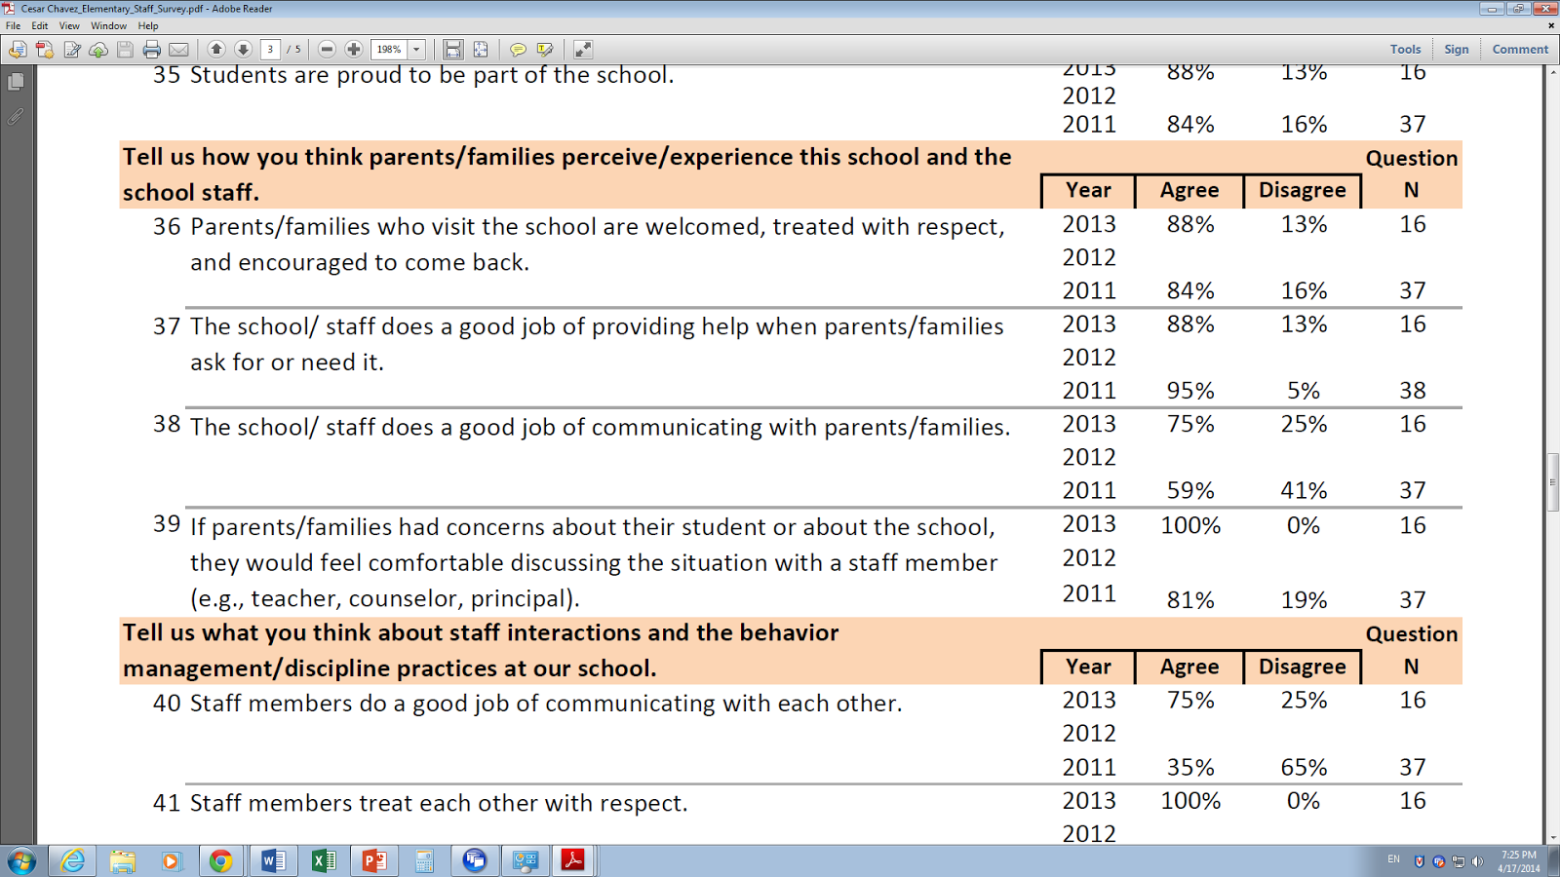

SCHOOL CLIMATE

Slide 24
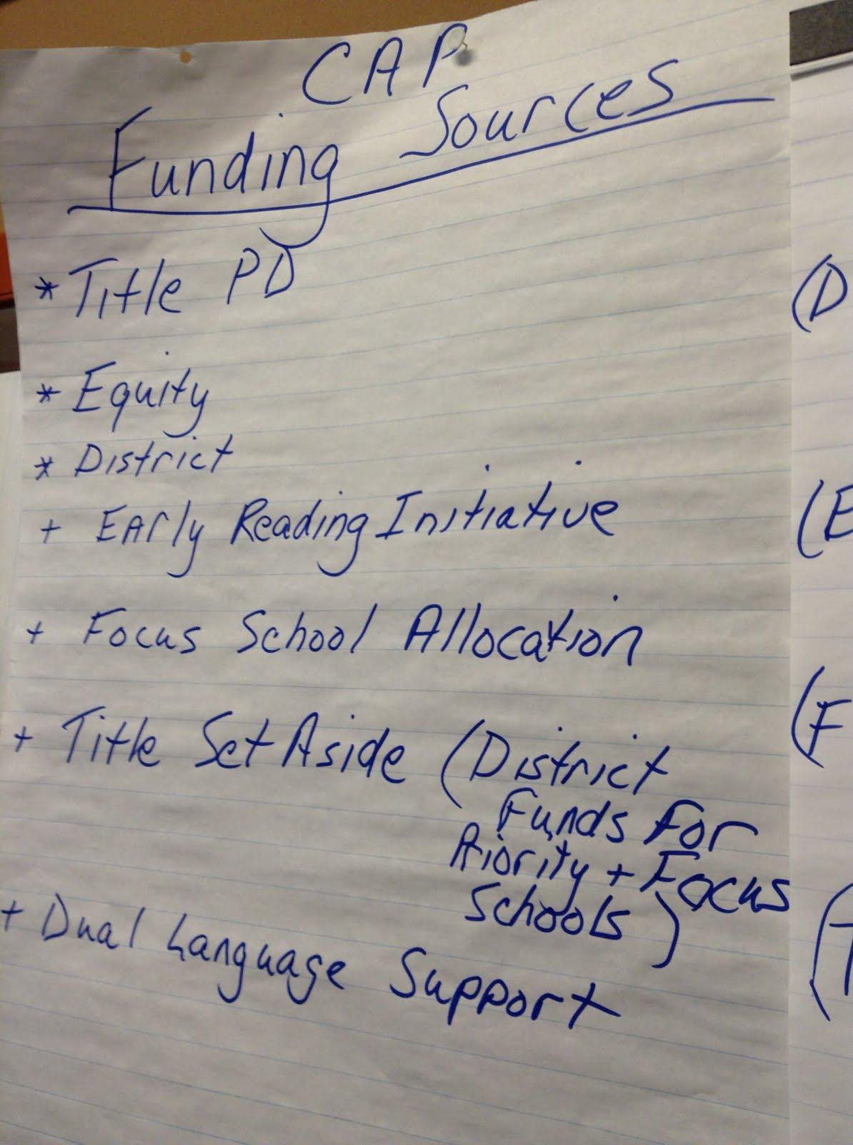
Budget Sources

Slide 25
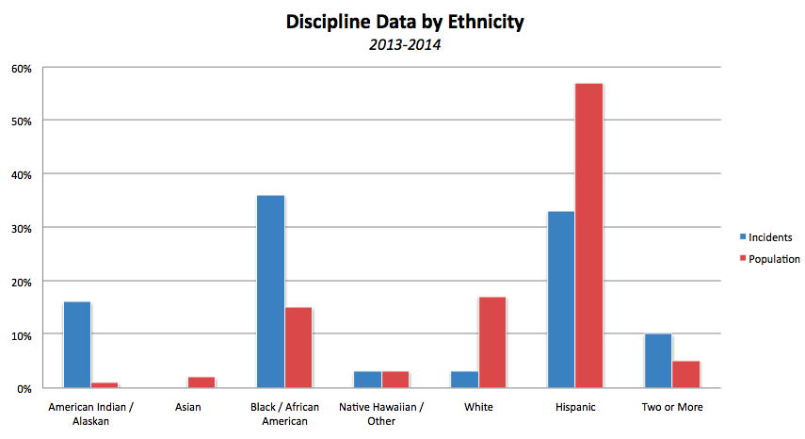

Slide 26
Blue Print: First Year
The Creation of RTI level Teams FOCUS ON
Content
Behavior
Engagement
Services and Needs

Slide 27
Content Interventions
Time to meet by teams to analyze, implement, change and include culturally relevant curricula and engagement activities for all students.
“My Family” Project

Slide 28
Technology-Motivation
$40,000 Technology Grant
iPads
Instructional Software ($199.00 per classroom)
We would like to secure 10 ipads solely for individualized work
“Kids that can feel motivated by the use.”

Slide 29
Behavior Interventions
Positive Interventions
Individual Plans of Positive Reward
$2,000 for Restorative Justice Training
“Relational Needs Identification” can be supported for teachers who serve as coaches and check-points for students who struggle

Slide 30
Class Room Support Systems
Common Expectation
Retraining of the expectations
Common Codes Signals for All Classes
“Standard” Behavioral Response - NONE COMPLIANCE.
“Standard” Second Steps
Standard Delay Response

Slide 31
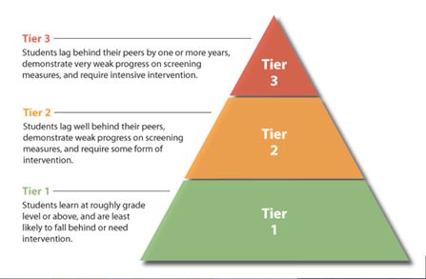
Tiered Intervention Pyramid

Slide 32
Tiered Intervention/Support/ Content
Tiered Interventions
Tier I interventions meet the needs of the majority of students through the use of a variety of differentiated tools and resources. These resources are available to all students, and are used to enhance and extend learning of Essential Skills and Standards.
Tier II interventions are designed to address the instructional needs of students who require additional support mastering the Essential Skills and Standards even after the use of Tier I resources. The strategic intervention and progress monitoring provided through the implementation of targeted supplemental instructional support programs (SISPs) helps to ensure students are receiving instruction that meets their individual needs.

Slide 33
Tiered Intervention/Support/Content
Tier III interventions
Include:
Highly intensive and individualized instruction (often a combination of Tiers I and II are used)
Small group one-on-one instruction
Increased intensity and duration for students showing a lack of adequate progress in Tiers I and II
Teachers and tutors are provided the tools to increase student achievement by applying age appropriate diagnostic reading/math methods within their classroom.
Essential Skills and Standards are used to track student progress regularly.

Slide 34
Tier I Resources
Skills Tutor
Skill review for the following:
* Language Arts (K–12)
* Math, Algebra I and II (K–12)
* Information Skills (6–12)
* Workforce Skills (9–12)
* Science (7–12)
Study Island
Standardized test preparation, reinforcement, and skill
review for the following:
* Language Arts (3–8*)
* Math (3–8*)
* Science*
* Writing*
* Availability varies by school and grade level

Slide 35
Tier II Resources
Phonemic awareness
Reading Eggs (K–2)
MimioSprout® (HeadSprout) (K–3)
Reading fluency and comprehension
Raz-Kids™ (K–5)
Reading Eggspress (2–6)
SuccessMaker® Reading (K–8)
Grade level math skills
Math-Whizz® (3–8)
SuccessMaker® Math (K–8)
Tier II Interventions listed in order of preference.

Slide 36
References
Oregon Department of Education. (1998-2014). Education Data Explorer. Retrieved from http://www.ode.state.or.us/apps/Navigation/Navigation.Web/#/PAGR
The Oregonian. (2013). Your Schools: Cesar Chavez School. Retrieved from http://schools.oregonlive.com/school/Portland/Clarendon-Portsmouth-School/. Oregon Live LLC.
Fixsen, D., Naoom, S., Blase, K., & Wallace, F. (2007, Winter/Spring). Implementation: The missing link between research and practice. The APSAC Advisor, 4–10. Retrieved from http://www.rtinetwork.org/getstarted/implement/create-your-implementation-blueprint-stage-3-initial-implementation

