Slide 1

Building a Community of Readers:
Best Practices in K-8 Literacy Instruction
Amber Anderson Kristin Lasher Kimberly Long Jorge Meza October 24, 2013
Notes:
We’d like to start our presentation of Building….. by bringing the lens of equity. Through all our discussions today we need to remember to think about all children how these best practices work with all students. We know the importance of keeping this forefront in our minds as we discuss best practices of instruction in all areas especially literacy.

Slide 2
Culturally Responsive Teaching
“ Teaching is most effective when ecological factors, such as prior experiences, community settings, cultural backgrounds, and ethnic identities of teachers and students, are included in its implementation” (Gay, 2010, p. 22)
Notes:
Geneva Gay shows us ways to be culturally responsive in our teaching. ELL teachers have done this for a long time but we need to be sure that all teachers do this for all their students. It is too easy to overlook prior experiences if those experiences are different from the teachers.

Slide 3
Leading for Social Justice By Frattura and Caper
Integrated Comprehensive Services (ICS) is where leaders must hold a core belief that all students should be educated in heterogeneous settings and possess the knowledge and skills to put this belief into action.
(Frattura & Caper, 2007)
Notes:
We also want to include the work of Frattura and Caper in Leading for Social Justice through ISC. This is a major paradigm switch for many teachers in K-8 schools. We have been very accustomed to homogeneous grouping especially for reading. Programs like “Walk to read” have been nationally implemented. This is where students would go to a completely different class sometimes a different grade level for reading at “their Level”. This was wrong on so many levels. No one adult felt responsible for the reading literacy of the students that left their classroom for instruction, students self esteem was lowered if then went to a lower grade for reading…

Slide 4
Resources Dilemma
Well-intentioned teachers, while trying to get extra support for their students, may be hurting them more than helping.
Clustering ELL students for services
At-risk students placed in alternative sites
Small groups of students with problems in one classroom makes it difficult to use resources without the child feeling singled out.
(Frattura & Caper, 2007)
Notes:
Frattura and Caper argue that pulling students out for homogenous grouping is only in the best interest for the teacher not the student. WEll intentioned teachers……. Frattura and Caper are very adamant that to to be a leader for social justice leaders must be sure that their schools use heterogeneous groupings.

Slide 5
Heterogeneous Groupings are Non-negotiable
All students get Core reading and math with whole class
Flexible Grouping is required to differentiate instruction through:
  small group
  one-on-one
  large group
Specialist teachers come into the classroom and work in groups with students: Title 1, ELL, SPED
(Frattura & Caper, 2007)
Notes:
This is working at schools with high numbers of students that qualify for services and therefore there are supports in place at the school. The schools that have low numbers of students in each class will struggle with this goal more. Classroom teachers are caught needing to meet the needs of students with a wide range of needs. Sometimes the need is to work one on one but there is no staff available to meet these needs.

Slide 6

All Children reading by 3rd grade: Laying a foundation for literacy success.

Slide 7
3rd Grade Reading Benchmark
Performance on reading assessments in 3rd grade is an early predictor of long-term academic achievement and the leading indicator of high school graduation rates
Difficult to catch up if reading below grade level at 3rd grade especially as content increases
Struggling readers are at higher risk of dropping out, highest risk for children living in poverty
(Hernandez 2012 as cited by National Governor’s Association)
Notes:
If 3rd grade is the make it or break it point, we have 4 short years from the time children enter kindergarten to give them the skills they need to be fluent readers and ultimately literate adults (scary).

Slide 8

States can increase the number of children who are proficient in reading by third grade by including three major and widely embraced results of educational research in their efforts:
Differences in literacy and language development in early childhood can lead to achievement gaps as early as kindergarten;
Reading proficiency requires a focus on interrelated skills and knowledge taught over time; and
Parents, primary caregivers and teachers have the most influence on children’s language and literacy development.
(National Governor’s Association, 2013)
Notes:
This comes from a document “A governor's guide to early literacy: Getting all children reading
by third grade” listed in our reference list. I found it through the Oregon Early Learning Council website.

Slide 9
Research/Policy Gap
Research shows:
Starting at kindergarten is too late.
Language and literacy development begins at birth.
Achievement gap is present before kindergarten.
High quality early learning experiences can help close the gap.
Current policy:
Insufficient access by low-income and working families to high-quality early childhood programs.
(National Governors Association, 2013)
Notes:
While research shows that kindergarten kids enter school with an achievement gap already in place, current policy doesn’t ensure access of all of our most at-risk kids to quality early childhood programs.

Slide 10
“30 million word gap by age 3”
Using the data from their study of family talk patterns in the home in “professional”, “working-class”, and “welfare” homes, Hart and Risely (2003) extrapolated the following differences in language exposure of the average child in poverty versus the average child in a professional home:
30 million fewer words heard by age 3;
Half as many words heard per hour;
1 encouragement to 2 discouragements
(vs. 6 encouragements to 1 discouragements)
The LENA study (Gilkerson & Richards, 2008) supported the Hart and Risely results

Slide 11
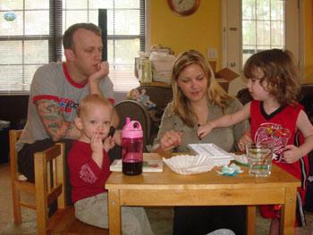
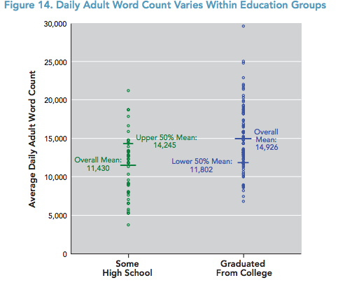
(Gilkerson & Richards, 2008)
Notes:
The LENA study used slightly different categories than Hart and Risely, using parent level of education as the SES indicator. Professional parents were found to use an average of almost 15,000 words a day, while parents with less than high school diploma used as average of 11, 400 words a day. That is 3,500 fewer words a day used to build the developing vocabularies of some young children.
Students must learn 3,000 words per year by 3rd grade to keep up
Only 400 words a year are directly taught by teachers
Everyday speech consists of only 5,000-7,000 words
Conversation cannot make up the difference

Slide 12
Access to High Quality Learning Experiences
Magnuson and Waldfogel (2006) asserted while incremental increases in preschool access would do little “substantial increases in Hispanic and black children's enrollment in preschool, alone or in combination with increases in preschool quality, have the potential to decrease school readiness gaps.”
(Magnuson & Waldfogel, 2006)
Black children are more likely to attend preschool than white children, but may experience lower-quality care.
Hispanic children are much less likely than white children to attend preschool (as of 2006).
Black and Hispanic children are more likely than white children to attend Head Start.
White children are more likely to attend private prekindergarten programs.
Notes:
Large scale study of preschool effectiveness has been difficult to complete due to complexities of the childcare/early education system. Studies of select programs have suggested quality preschool/early childhood programs can be of significant benefit to children in poverty.

Slide 13

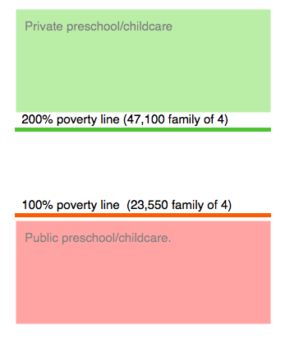
Higher percentage of White children
Quality varies considerably
Little oversight
Many program models
Academic benefits less studied
Higher percentage of Black children
Percentage of Latino children increasing
Head Start - Federally regulated, recent changes in teacher qualifications
Subsidized childcare - quality varies considerably

Slide 14
What can schools do?
Familiarize yourself with the early childhood resources in your area.
Library (storytimes, reading incentive programs)
Home visiting programs
Head Start/public preschool programs
Childcare resource and referral
Brochures or phone numbers in the office.
Bulletin board of early childhood resources

Slide 15
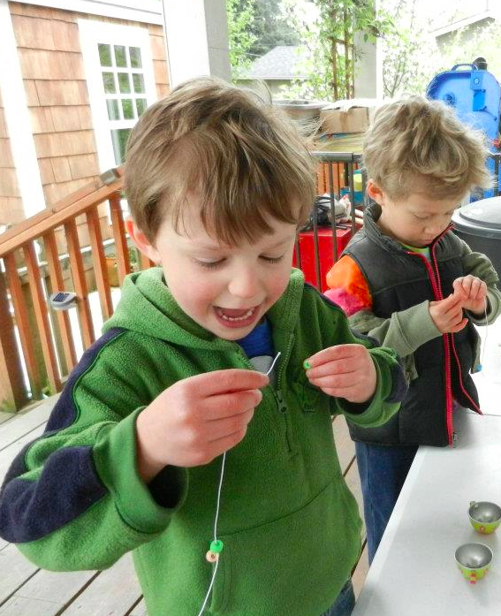
What can schools do?
Partner with early childhood programs, such as
Space for an ECSE classroom with neighborhood peers
Space for playgroups (homevisiting programs)
Public/private partnerships
Preschool information table at kindergarten round-up

Slide 16
Policy Gap
Research shows:
Reading proficiency requires 3 sets of interrelated skills and knowledge taught and cultivated over time
language and communication skills (oral language, vocabulary, comprehension)
mechanics of reading (letter-sound correspondence, decoding, reading fluency)
content knowledge (knowledge of facts and concepts to help understand new text)
Current policy:
Typically supports a narrower focus on the mechanics of reading within standards, curricula, and assessment
Often does not adequately support the full breadth of language and literacy skills among dual language learners.
(National Governors Association, 2013)
Notes:
While reading proficiency requires oral language skills, content knowledge, and mechanics, current policy focus primarily on mechanics (letter-sound knowledge) in emergent readers with little attention the broader components.

Slide 17
Policy Gap
Research shows:
Parents, primary caregivers, and teachers have the most influence on children’s language and literacy development
Current policy:
Often fails to equip these adults with skills and knowledge to teach children effectively and support them at all stages of development.
(National Governors Association, 2013)
Notes:
Amber
While parents have a significant influence on children’s language and literacy development, parents are underutilized or are unsure what they can do to support their child in learning to read.

Slide 18
Research has found
Early reading experiences through family support is critical in developing children’s early literacy skills.
Fostering reading partnerships between parents/caregivers and their children is important in helping to create foundational reading skills and positive attitudes towards reading readiness and early literacy development.
(Sukhram,& Hsu, 2012)

Slide 19
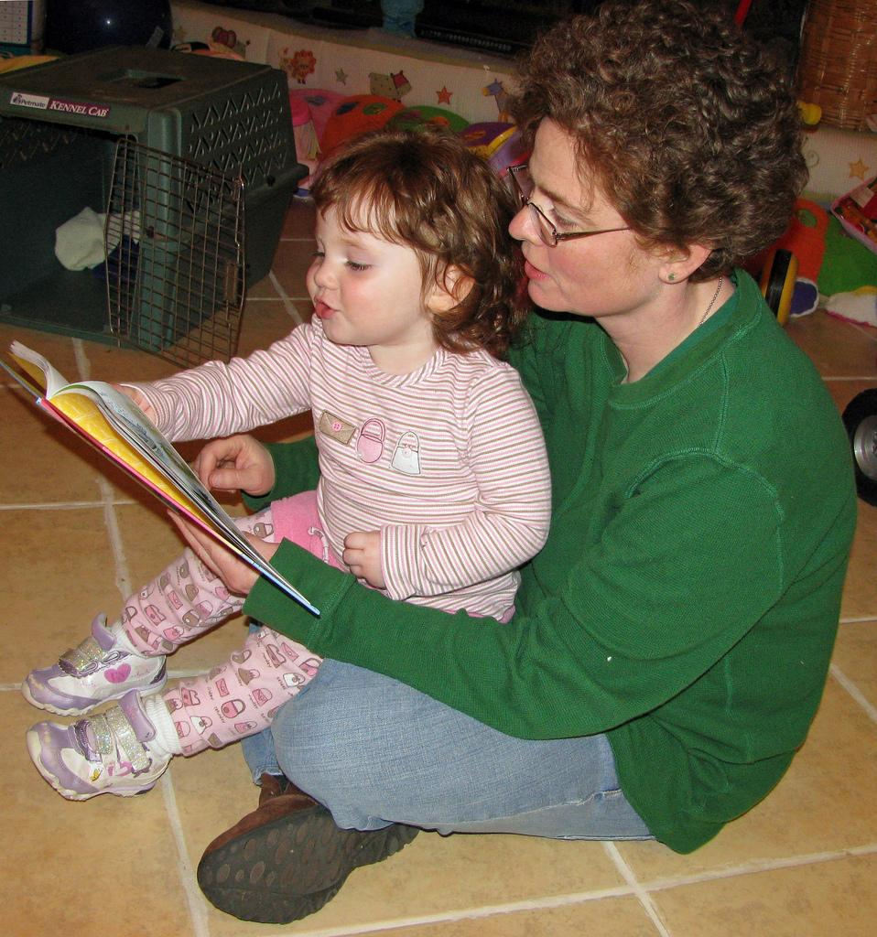
Parent-Child Reading
Practices
Hood, Conlon, and Andrews (2008) cited multiple studies showing an association between parent-child reading and emergent literacy skills.
Their study supported Sénéchal’s work that parents engage in different types of reading practices, serving related but different purposes in early literacy.
Storybook reading
Literacy Teaching Activities
(Hood, Conlon, & Andrews, 2008)
Notes:
Multiple studies have linked parent-child storybook reading to advanced language skills usually measured as receptive vocabulary. The amount of reading by kindergarten teachers has also been tied to vocabulary. Most studies reviewed in the Hood, Conlon, and Andrews (2008) article failed to find a link between parent-child storybook reading and children’s letter knowledge. Parent-child literacy teaching activities were found to be linked to reading mechanics in 1st and 2nd grades (parents need a bit more training to do these activities). Literacy teaching activities effective across SES and with parents with low literacy.
Storybook reading was not found to be directly related to reading skill in 2nd grade, but it has been suggested that the benefits of storybook reading are seen in 3rd grade and beyond as kids begin to read for content, reaping the benefit of their stronger vocabularies.

Slide 20

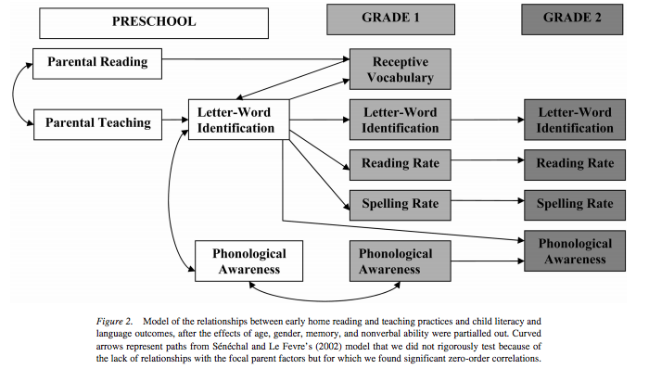

Slide 21
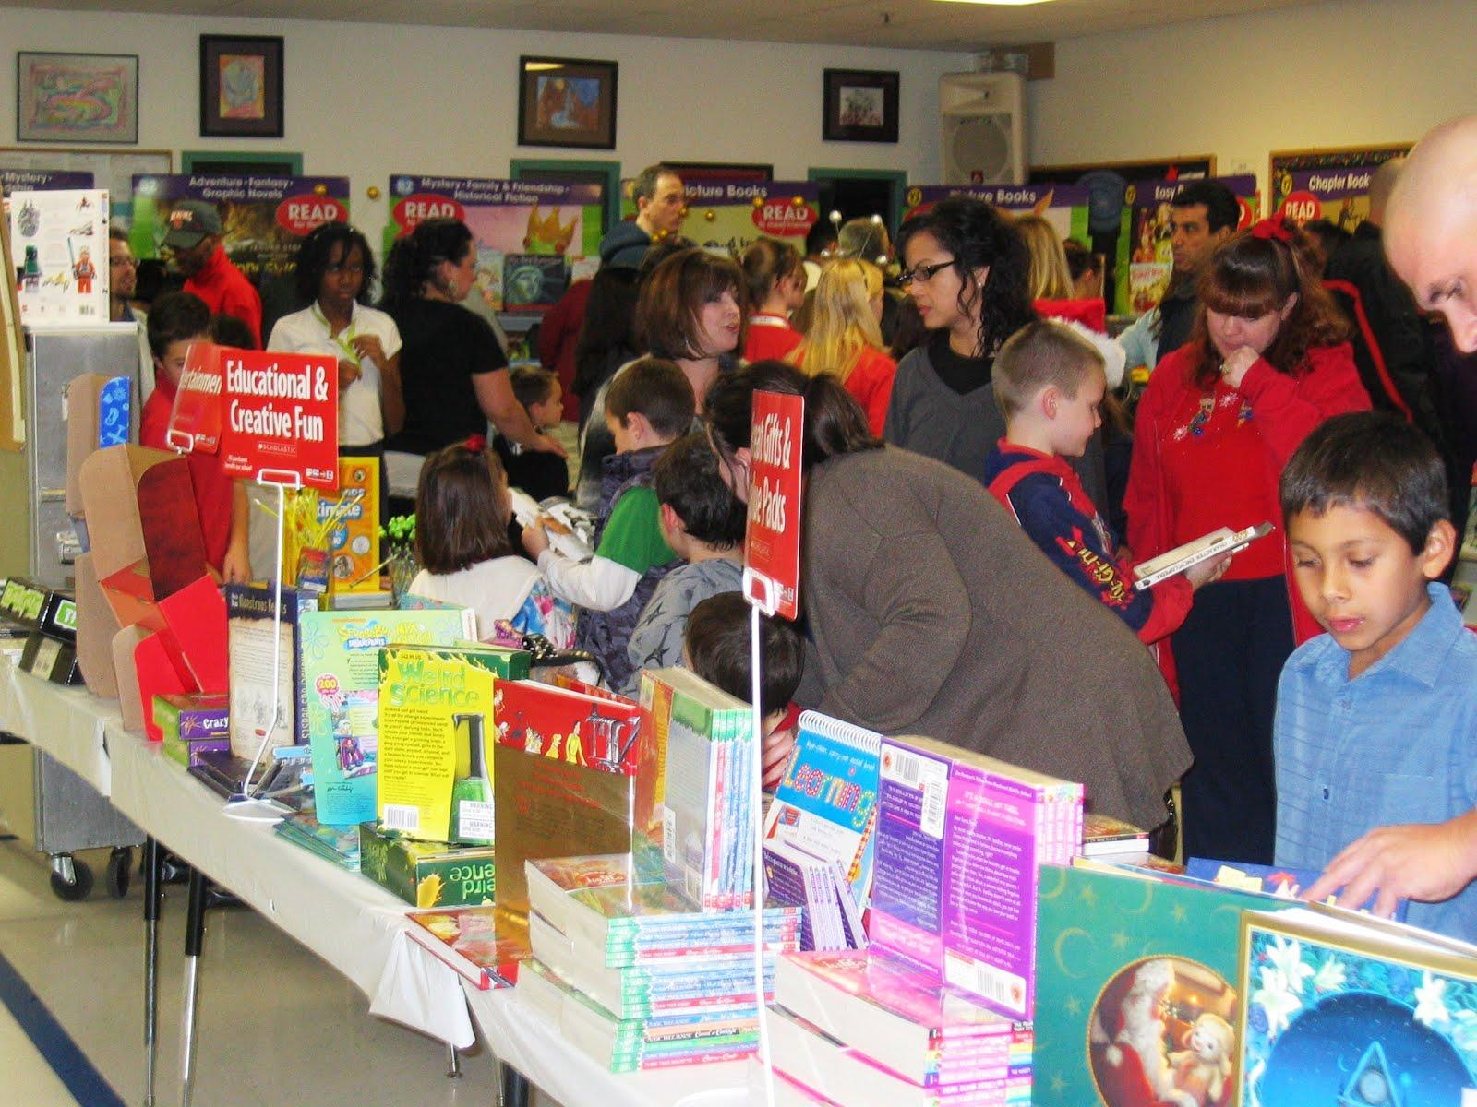
Family Literacy Nights/Events
Host a Book Fair event at your school
Introduce families to your school library and educate them on how your school’s reading program works.

Slide 22

Family Literacy Nights/Events
Book Swap: Ask every student signed up to donate a gently used book. Ask the students to bring the book ahead of time so you can have the books sorted by age group and tables set up accordingly.

Slide 23
Family Literacy Nights/Events
Provide parents with reading strategies and tips that they can use at home with their children.
Explain to them how to select books at their child’s reading level.
Stress that reading at home and with their child is fundamental to their child’s success.
(Library Media Connection, 2007)

Slide 24

Great Resource for Teachers
Involving Parents in Their Children’s Reading Development: A Guide for Teachers. Written by Bruce Johnson, 2008
A veteran reading specialist, offers advice for helping parents of prereaders and struggling readers, as well as tips for maintaining reading skills through the summer.

Slide 25
School to Home Connections
Suggest activities to parents, such as:
• Read or look at books, magazines, or the newspaper with your child. Talk about what you looked at or read.
• Visit the library and check out books and magazines to read at home.
• Tell stories together about books, about your family, and about things that you do.
• Talk about written material you have such as catalogs, advertisements, work-related materials, and mail.
(Reading Today, December, 2003)

Slide 26
School to Home Connections (continued)
Reward your child's attempts at reading and writing, even if they are not perfect.
Be sure that reading and writing are enjoyable experiences.
Sign up for Reading Rewards at http://www.reading-rewards.com
Online books at http://www.biguniverse.com
For more strategies see Reading Today, December, 2003

Slide 27

The Tools Needed for Reading Success:
Best Practices K-5

Slide 28
Common Core Reading Standard 10 K-5
K Actively engage in group reading activities with purpose and understanding.
With prompting and support, read prose and poetry [informational texts] of appropriate complexity for grade 1.
By the end of the year, read and comprehend literature [informational texts] in the grades 2–3 text complexity band proficiently, with scaffolding as needed at the high end of the range.
By the end of the year, read and comprehend literature [informational texts] at the high end of the grades 2–3 text complexity band independently and proficiently.
By the end of the year, read and comprehend literature [informational texts] in the grades 4–5 text complexity band proficiently, with scaffolding as needed at the high end of the range.
By the end of the year, read and comprehend literature [informational texts] at the high end of the grades 4–5 text complexity band independently and proficiently.
Notes:
It is important to have the Common Core in the forefront when thinking about literacy in K-5.

Slide 29
National Reading Panel
The National Reading Panel (NRP) issued a report in 2000 that responded to a Congressional mandate to help parents, teachers, and policymakers identify key skills and methods central to reading achievement. The Panel was charged with reviewing research in reading instruction (focusing on the critical years of kindergarten through third grade) and identifying methods that consistently relate to reading success.
Notes:
The majority of the content that I will be covering is based on findings of the national reading panel that was formed in response to the overwhelming failure of our nations schools to adequately teach our nations children to read. The focus of the national reading panel was focused on grades k-three the critical years that research shows is the time children should learn to read, in order to be able to read to learn in the later years.

Slide 30

National Reading Panel
The National Reading Panel's analysis made it clear that the best approach to reading instruction is one that incorporates:
explicit instruction in phonemic awareness
systematic phonics instruction methods to improve fluency
ways to enhance comprehension.
Notes:
The National Reading Panel (NRP) issued a report in 2000 that responded to a Congressional mandate to help parents, teachers, and policymakers identify key skills and methods central to reading achievement. The Panel was charged with reviewing research in
reading instruction (focusing on the critical years of kindergarten through third grade) and identifying methods that consistently relate to reading success.
The Panel reviewed more than 100,000 studies. And came out with following findings.

Slide 31

The Five Big Ideas in Beginning
Reading
Phonemic Awareness
Alphabetic Principle
Fluency with Text
Vocabulary
Comprehension
Notes:
From the findings and review of the research the five big ideas in reading where established as the basis of the most effective components to reading success in students k-3

Slide 32
Phonemic Awareness (PA) is:
The ability to hear and manipulate the sounds in spoken words and the understanding that spoken words and syllables are made up of sequences of speech sounds (Yopp, 1992).
Essential to learning to read in an alphabetic writing system, because letters represent sounds or phonemes. Without phonemic awareness, phonics makes little sense.
Notes:
The first and most building block to reading is phonemic Awareness which is;

Slide 33
Phonemic Awareness (Continued)
Fundamental to mapping speech to print. If a child cannot hear that "man" and "moon" begin with the same sound or cannot blend the sounds /rrrrrruuuuuunnnnn/ into the word "run", he or she may have great difficulty connecting sounds with their written symbols or blending sounds to make a word.
Essential to learning to read in an alphabetic writing system.

Slide 34

Alphabetic Principle
Alphabetic Understanding: Words are composed of letters that represent sounds.
Phonological Recoding: Using systematic relationships between letters and phonemes (letter-sound correspondence) to retrieve the pronunciation of an unknown printed string or to spell words.
Notes:
The next of the five big ideas is alphabetic principle which is the understanding that;

Slide 35
Fluency
Fluency (automaticity) is reading words with no noticeable cognitive or mental effort. It is having mastered word recognition skills to the point of overlearning. Fundamental skills are so "automatic" that they do not require conscious attention.
Examples of automaticity:
shifting gears on a car
playing a musical instrument
playing a sport (serving a tennis ball)
Notes:
The third of the big ideas of reading is fluency which is extremely important to building fluent readers; While fluency is usually an indicator of a fluent reader with good comprehension, in some cases with children who are English Language learners or Special Ed the reading fluency doesn’t always equal high comprehension.

Slide 36

Vocabulary
Learning, as a language based activity, is fundamentally and profoundly dependent on vocabulary knowledge. Learners must have access to the meanings of words that teachers, or their surrogates (e.g., other adults, books, films, etc.), use to guide them into contemplating known concepts in novel ways (i.e. to learn something new).
(Baker, Simmons, & Kame'enui, 1998)
Notes:
Vocabulary is the mortar the holds the bricks of reading together because if a child doesn’t possess the vocabulary necessary to understand what he or she is reading then the reader is reading without any meaning or comprehension.

Slide 37

Comprehension
The essence of reading
Active and intentional thinking in which the meaning is constructed through interactions between the text and the reader (Durkin, 1973).
Comprehension: the complex cognitive process involving the intentional interaction between reader and text to extract meaning
Notes:
Comprehension is the fifth and in my opinion the most important component of the five big ideas to producing a fluent reader because with out comprehension the whole function of reading is useless.

Slide 38
Comprehension Strategies
Activate background knowledge and use to make meaning out of text
Generate and ask questions while reading
Evaluate or draw conclusions from information in a text
Get meaning by making informed predictions
Monitor comprehension including knowing when they understand and what they don’t understand, and using additional strategies to improve when understanding is blocked
Derive meaning of narrative and expository text by being able identify relevant text structures
(Bursuck & Damer, 2007)
Notes:
these are some comprehensions strategies to help child make sense of what they’re reading

Slide 39

Students at Higher Risk for Reading Difficulties
Students raised in poverty
Student with limited access to books or text
Students with learning disabilities
Student who speak English as a second language
Students that may have been born prematurely (Bursuck, & Damer, 2007)
Notes:
In reading there is disportionate amounts of children at risk of not becoming readers in our schools

Slide 40

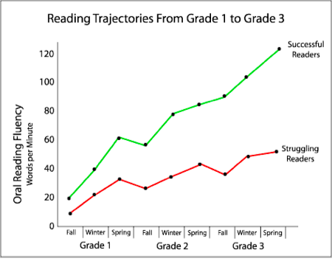
The Scope of Reading in the U.S.
Students in the bottom 25% of the reading continuum have a trajectory of progress that diverges early from their peers who have learned to read successfully
Notes:
here’s a graphic just showing the gap grows in later years if not caught early;
"Overall, national longitudinal studies show that more than 17.5 percent of the nation's children--about 10 million children--will encounter reading problems in the crucial first three years of their schooling" (National Reading Panel Progress Report, 2000).
Approximately 75% of students identified with reading problems in the third grade are still reading disabled in the 9th grade. (Shaywitz, et al., 1993; Francis et al., 1996)
In a sample of 54 students, Juel (1988)found the probability of being a poor reader in fourth grade given you were a poor reader in first grade was 88%.
"...a longitudinal study of students with poor word identification skills in the third grade (Felton & Wood, 1992) indicated that most of these students failed to significantly improve their skills by the end of eighth grade." (Felton & Pepper, 1995)

Slide 41
Most Effective Way to Teach Essential Reading Skills to Children Who Are at Risk
Instruction has to be Explicit and Systematic;
Explicit Instruction-is the clear, direct teaching of reading skills and strategies that include:
Clear Instructional Outcomes
Clear purpose for learning
Clear and understandable directions and explanations
Adequate modeling/demonstration, guided practice, and independent practice as part of the teaching process
Clear consistent corrective feedback on student success and student errors

Slide 42

Differentiated
Instruction
Schools need a range of instructional options to meet the diverse needs of their students. (Tomlinson, 2000)
Differentiated instruction in reading can be done through the three-tiered system where students receive the level of support necessary for them to read at or above grade level.(Bursuck & Damer, 2007)
Notes:
we also know that we have to differentiated instruction to meet all students needs,

Slide 43

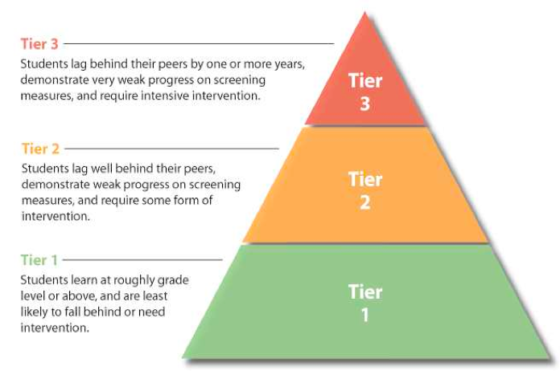
Notes:
One way that many schools do that is by tiering children

Slide 44
Ability Groups vs. Tiered Groups
Ability Groups:
Label student differences.
Number of groups is more constant--Typically a high, middle, and low-skill group. Instruction is organized around that preset number of groups.
Stagnate: Student membership within groups remains nearly the same for most students’ needs, instructional objectives, of the year. Topics and tasks change.
Placement is based upon the assessment of past achievement.

Slide 45
Ability Groups vs. Tiered Groups (continued)
Instruction responds to students’ perceived ability level of each group.
Specific concepts and skills vary with the perceived ability level of each group. Different concepts and skills are taught.
Expectations may vary depending upon the ability level of the students.
Ability labels and assessment
drive ability grouping.

Slide 46
Ability Groups vs. Tiered Groups (continued)
Tiered Groups
Pre-assessment determines how instruction is organized for a segment of learning. At times, there might be one or two groups; at other times The groups respond to student learning readiness levels may dictate that four or more groups are needed.
Flexible: Membership within groups shifts as students’ needs, instructional objectives Topics, and tasks change.
Placement is a temporary instructional response to pre-assessment.

Slide 47
Ability Groups vs. Tiered Groups (continued)
Instruction is customized to learners’ readiness and profiles.
The same concepts and skills are taught, practiced, or extended at varying levels of complexity to all groups.
Expectations of continuous learning for all students prevail.
Pre-assessment, ongoing assessment
and student needs
drive tiered grouping.

Slide 48
Example of Tier 2 Reading Interventions: Elementary
Accelerated Reader: http://www.renlearn.com/ar/
• Basal reading series (classroom practice)
• Compass Learning Odyssey: http://www.compasslearning.com/why-compasslearning/odyssey.php
• Corrective Reading: https://www.mheonline.com/programMHID/view/0076181804
• Drill/flashcards (classroom practice)
• Early Intervention in Reading (EIR): http://ies.ed.gov/ncee/wwc/InterventionReport.aspx?sid=156
• Guided reading (classroom practice)
• Individualized instruction/tutoring (classroom practice)
• Leveled Literacy Intervention: http://www.heinemann.com/fountasandpinnell/lli_Overview.aspx
• Peer-Assisted Learning Strategies: http://ies.ed.gov/ncee/wwc/reports/english_lang/pals/index.asp
• Read 180: http://read180.scholastic.com/reading-intervention-program
• Read Naturally: http://www.readnaturally.com/
• Reader’s theatre (classroom practice)
• Reading Mastery: http://www.mcgraw-hill.co.uk/sra/readingmastery.htm
• Reading Recovery: http://ies.ed.gov/ncee/wwc/InterventionReport.aspx?sid=420
• Reciprocal Teaching: http://www.readingrockets.org/strategies/reciprocal_teaching/
• Rigby PM: http://rigby.hmhco.com/en/rigbyPM_home.htm
• SOAR to Success: http://www.hmheducation.com/store/reading/intervention.php
Notes:
this is a list of interventions and supplements that can help all readers

Slide 49

Building Comprehension:
Best Practices 6-8

Slide 50
Common Core Reading Standard 10 6-8
By the end of the year, read and comprehend literature [informational texts, history/social studies texts, science/technical texts] in the grades 6–8 text complexity band proficiently, with scaffolding as needed at the high end of the range.
By the end of the year, read and comprehend literature [informational texts, history/social studies texts, science/technical texts] in the grades 6–8 text complexity band proficiently, with scaffolding as needed at the high end of the range.
By the end of the year, read and comprehend literature [informational texts, history/social studies texts, science/technical texts] at the high end of the grades 6–8 text complexity band independently and proficiently.
Notes:
It is important to have the Common Core in the forefront when thinking about literacy in 6-8.

Slide 51
Culturally Responsive Teaching Ex.
The Advancement Via Individual Determination (AVID) project Mehan et al., 1996; Swanson et al., 1995
Low- achieving Latino and African American students are encouraged to enroll in advanced-placement classes.
Including “Social Scaffolding.” These are social and person supports that buffer students as they are being taught high-level skills and how to take ownership of their own learning. (Gay, 2010 p. 35)
Notes:
I do support Fratura and Caper’s position in Leading for Social justice suggests that Especially in grades 6-8 we need to remember to use heterogeneous groups, However, it is imperative to have the supports in place to help all students succeed. Geneva Gay sights the AVID ( Advancement Via Individual Determination) project as a good example of being culturally responsive.
.

Slide 52

Think Outside the Box
What other ways can students get information besides reading?
How can we use technology to meet the needs of students that can not read well enough to meet the common core competencies in grades 6-8?
Notes:
Using programs like AVID will help keep kids in school. We also need to think about other ways to meet the needs of our students in middle years.
District Level- Use TOSA
Building Level- Title 1 coordinators

Slide 53

Apps To Help Students with Dyslexia or Reading Difficulties
learning disabilities.
Learning Ally iBooks
howsjay Pronunciation Dictionary
Kindle ZoomReader
TuneWiki Lyrics ClaroSpeak US
OverDrive Media Console
SoundHound Read2Go
Foorman, B.R., Francis, D.J., Beeler, T., Winikates, D., & Fletcher, J.M. (1997)

Slide 54
Tier 2 Resources
Building Resources
Title I teachers, reading specialist
District Level Resources
District website, TOSA
Public Websites
National Center for Learning Disabilities
ODE Website
ReadOregon
Notes:
When looking for resources for your Tier 2 level reading. Look to your district resources first.

Slide 55
References
Baker, Simmons, & Kame'enui. (1997). Vocabulary acquisition: Research bases. In Simmons, D. C. & Kame'enui, E. J.
(Eds.), What reading research tells us about children with diverse learning needs: Bases and basics. Mahwah,
NJ: Erlbaum.
Bursuck, William D.,& Damer, Mary (2007). Reading instruction: For students who are at risk or have disabilities,
10-11,256-259.
Common core state standards for English language arts and literacy in history/ social studies, science and
technical subjects. (n.d.). Appendix A: Research supporting the key elements of the standards. Retrieved from
http://www.corestandards.org/assets/Appendix_A.pdf
Eunice Kennedy Shriver National Institute of Child Health and Human Development, NIH, DHHS. (2000).
Report of the National Reading Panel: Teaching children to read (00-4769).Washington, DC: U.S. Government
Printing Office. Retrieved from https://www.nichd.nih.gov/publications/pages/pubs_details.aspx?from=&pubs_id=89
Felton, R. H., & Pepper, P. P. (1995). Early identification and intervention of phonological deficits in kindergarten and
early elementary children at risk for reading disability. School Psychology Review, 24, 405-414.
Felton, R. H., & Wood, Frank B. (1992). A reading level match study of nonword reading skills in poor readers with
varying IQ. Journal of Learning Disabilities, 25, 5, 318-326.
Foorman, B.R., Francis, D.J., Beeler, T., Winikates, D., & Fletcher, J.M. (1997). Early interventions for children with
reading problems: Study designs and preliminary findings. Learning Disabilities: A Multidisciplinary Journal. 8, 6 72.
Frattura, E.M., & Capper, C. A. (2007). Leading for social justice: Transforming schools for all learners. Thousand Oaks,
CA; Corwin Press.
Flynn, K. S. (November 01, 2011). Developing children's oral language skills through dialogic reading: Guidelines for
implementation. Teaching exceptional children, 44, 2, 8-16.

Slide 56
References
Gay, G. (2010) Culturally responsive teaching: Theory, research, and practice. Teachers College Press, p. 22.
Gilkerson, J., & Richards, J.A. (2008) The power of talk (2nd Ed.). Infoture Technical Report ITR-01-2. Boulder, CO: The
LENA Foundation.
Green, J.F. (1996). LANGUAGE! Effects of an individualized structured language curriculum for middle and high school
students. Analysis of Dyslexia. 46, 97-121.
Hart, B., & Risley, T. R. (June 06, 2003). The early catastrophe. The 30 million word gap. American Educator, 27, 1,
4-9.
Hood, M., Conlon, E., & Andrews, G. (May 01, 2008). Preschool home literacy practices and children's literacy
development: A longitudinal analysis. Journal of Educational Psychology, 100, 2, 252-271.
Johnston, P. & Winograd, P.N. (1985). Passive failure in reading. Journal of Reading Behavior. 17, 279-299.
Lyons, G.R., & Moats, L.C. (1997, November/December). Critical conceptual and methodological considerations in
reading intervention research. Journal of Learning Disabilities. 30 (6), 578-588.
Magnuson, K. A., & Waldfogel, J. (January 01, 2005). Early childhood care and education: Effects on ethnic and racial
gaps in school readiness. The Future of Children, 15, 169-196.
National Association of Education Progress (1999). Reading report card for the nation and the states. Arlington,
Virginia: Educational Research Service.
National Center for Learning Disabilities. (2013). Retrieved from http://www.ncld.org/students-disabilities/assistive-
technology-education/apps-students-ld-dyslexia-reading-difficulties
National Reading Panel (2000). Teaching children to read: An evidence-based assessment of the scientific research
literature on reading and its implications for reading instruction: online. Retrieved from
http://www.nichd.nih.gov/publications/nrp/smallbook.htm.

Slide 57
References
National Governors Association. (2013, October 1). A governor's guide to early literacy: Getting all children reading
by third grade. Retrieved from http://www.nga.org/.
Oregon Department of Education. (2002).Teaching and learning to standards. 301 Reading and literature – Helping
non-readers, Options 1-3. Retrieved from
http://www.ode.state.or.us/teachlearn/subjects/elarts/reading/curriculum/helpingnonreaders.pdf
Pierce, P. (2004) Center for Literacy and Disability Studies. The hour glass model of literacy development and
instruction [Powerpoint Slides]. Retrieved from http://www.med.unc.edu/ahs/clds/.
Read Oregon. (n.d.). Reading resource links: Retrieved from http://readoregon.org/rdg_resources.htm#lit
Rehmer, J. (2007). Family reading night: A how to guide. Library Media Connection, 25(7), 16-17.
Roswell, F.G., & Chall, J.S. (1992). Diagnostic assessments of reading. Chicago: Riverside.
Sénéchal, M., & Young, L. (December 01, 2008). The effect of family literacy interventions on children's acquisition of
reading from kindergarten to grade 3: A meta-analytic review. Review of Educational Research, 78, 4, 880-907.
Shaywitz. S. (2003). Overcoming dyslexia: A new and complete science-based program for reading problems at any
level. New York: Knopf.
Stanovich, K.E. (1994, January). Romance and reality. The reading teacher. 474), 280-289.
Sukhram, D., & Hsu, A. (2012). Developing reading partnerships between parents and children: A reflection on the
Reading Together Program. Early Childhood Education Journal, 40(2), 115-121.
Supporting children's literacy growth: Tips for parents. (2003). Reading Today,21(3), 16.

Slide 58
References
University of Oregon. (n.d.). Five big ideas in beginning reading:Center on teaching and learning. Retrieved from
http://reading.uoregon.edu/big_ideas/
Yopp, H. K. (1992). Developing phonemic awareness in young children. Reading Teacher, 45, 9, 696-703.

