Slide 1
Adolescents at School Michael Sadowski
Lisa Dailey, Amber Anderson, Heidi Buchanan

Slide 2

Identity
Personal, everyday experiences:
successes & failures
routines
habits
rituals
novelties
thrills
threats
violations
frustrations
Influences:
gratifications
reinforcements
Who am I?
Notes:
Identify is unique (p.11) but so is what/who we are most greatly influenced by (p.13).

Slide 3
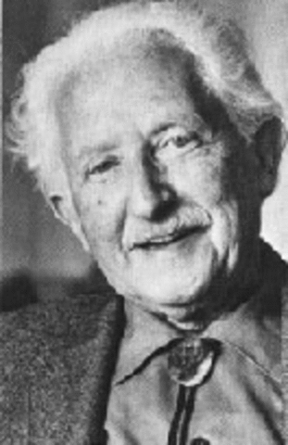
Crisis as Opportunity
Erik Erikson
Crossroads
What life courses You ain’t should I pursue? gonna change
me!
Mac: “It’s who I am, man. I can’t change that…. They should know that.” (p. 11)
Joaquin: Respect = intimidating & menacing others (p. 24)
Nelda: Dual identity → Mexican & Chicana (p.73)
“High-achieving” Asian-American: “...you tend to be what they expect… and you just lose your identity… just lose being yourself.” (p.81)
Notes:
How did each of these adolescents define themselves in the time of crisis?

Slide 4
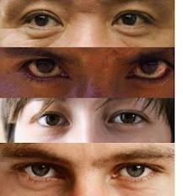
The Awareness of Race
Integrated settings = less awareness of physical differences (p. 25)
Acceptance and affirmation by others often defines one’s own awareness of their race (p. 26)
Fear of rejection and being known as a traitor within own racial group (p. 27)
Notes:
Children who grow up in more integrated settings are less aware of physical differences.
African-Americans may view Mexican-Americans as “white” but as Mexican-American kids get older, they realize they are not white.
Behavior outside of racial norms may lead to rejection.

Slide 5
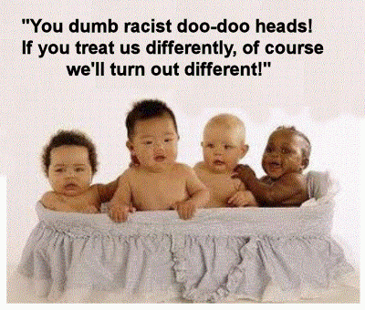
Stereotypes
Academically:
White students > black students (p.29)
Asian students > latino students (p. 29)
Students in “slow” classes are not smart (p. 30)

Slide 6
Creating Possibility
Deficient and in need of treatment vs. sufficient with engaging opportunities
Mentoring programs (p.16)
Sports & other extra-curricular activities (p.16, 61)
Reciprocal transformation (p.19)
Educator Student
Incorporate relevant history & culture into curriculum (p.32)
Don’t talk about jobs & money, encourage learning & educating oneself (p.43)
Encourage students to join groups/classes outside of their norm (p. 32)
Notes:
Reciprocal thinking: adult is changed by student and student is changed by adult (p.19)
Why are we learning this? Urban kids and easily get a job and money dealing drugs - don’t talk about the financial aspects of school

Slide 7
Hidden Curriculum
“The hidden curriculum related to race presents racial patterns as normal and effectively reinforces racial stereotypes. When it is operative it can completely undermine efforts to raise student achievement because students may believe that altering racial patterns simply is not possible.” (p. 31)
Questions:
Can you think of an instance when you witnessed this?
How can you be an agent of change to help remove any hidden curriculums inside your building or classroom?
How can you encourage students to believe altering racial patterns is possible?

Slide 8
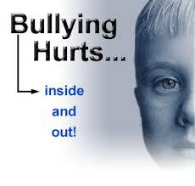
Bullying
Causes torment, fear, isolation, and anger
Many students who have acted out in “violent glories” trying to demand respect for themselves experienced various forms of bullying. (p.74)
Notes:
We are all familiar with the horrible school shooting stories. When the shooters of Columbine were questioned as to why they did what they did they both expressed that (Read the quote on the next slide)

Slide 9

Bullying
“They felt they had no other friends to validate their fragile and threatened identities; they felt that school authorities and parents would be unresponsive to their plight; and they had no access to other methods of self-affirmation” (p.75).
Be aware of withdrawn students.
Praise students on what they are doing well.
Let students know that you care, be human.
Create a school/classroom environment that doesn’t tolerate bullying in any form

Slide 10

Character Education
Fundamental to violence prevention
Everybody in our school lives by some core values.
Bullying is incompatible with the culture of the school
Everyone is responsible
Be responsive when incidents are reported--discuss, educate, do something about it! (p. 82)

Slide 11

Identity Development
“Young people experience the crisis of identity formation most acutely during adolescence”, stated Erick Erickson (1968, p. 128), the well know adolescent psychologist.
striving to know and accept who they are
trying to establish a positive sense of self
envisioning a future role for themselves as adults
keen awareness of how others view/perceive them
SEXUAL IDENTITY IS INCLUDED IN THIS PROCESS

Slide 12
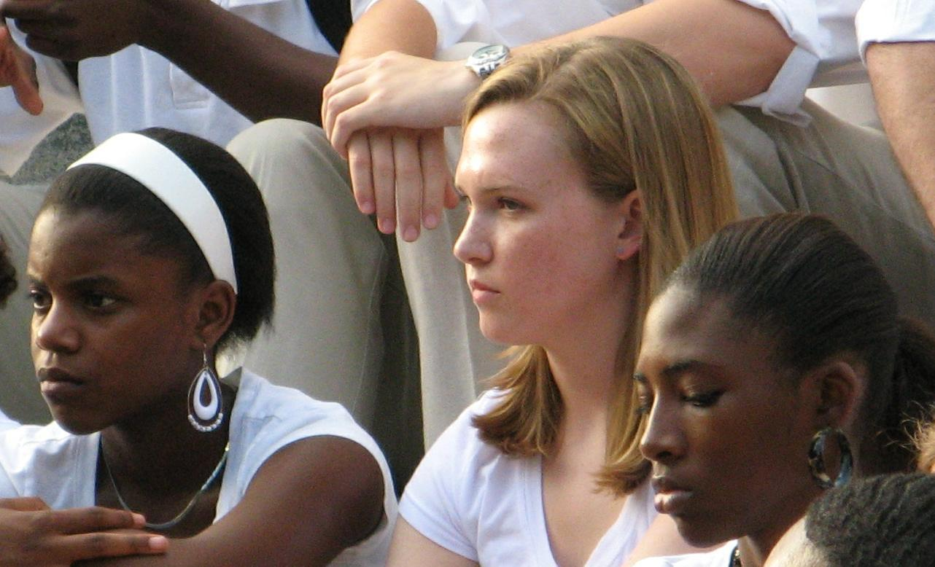
Sexual Minorities (LGBT)
The 2001 Massachusetts Youth Risk Behavior Survey (MYRBS), found that, “among the 5 percent of students who identified themselves as lesbian, gay, or bisexual, nearly one out of three (31%) had attempted suicide in the past year” (p.87). This number is four times higher than the 8% reported for other students not belonging to a sexual minority group.
Includes lesbian, gay, bisexual, and transgender youth.
Identifying oneself with this group is not always accepted in several school environments.
Notes:
(MYRBS) includes responses of more than 4,000, randomly selected youth from the state of Massachusetts’ high schools.

Slide 13
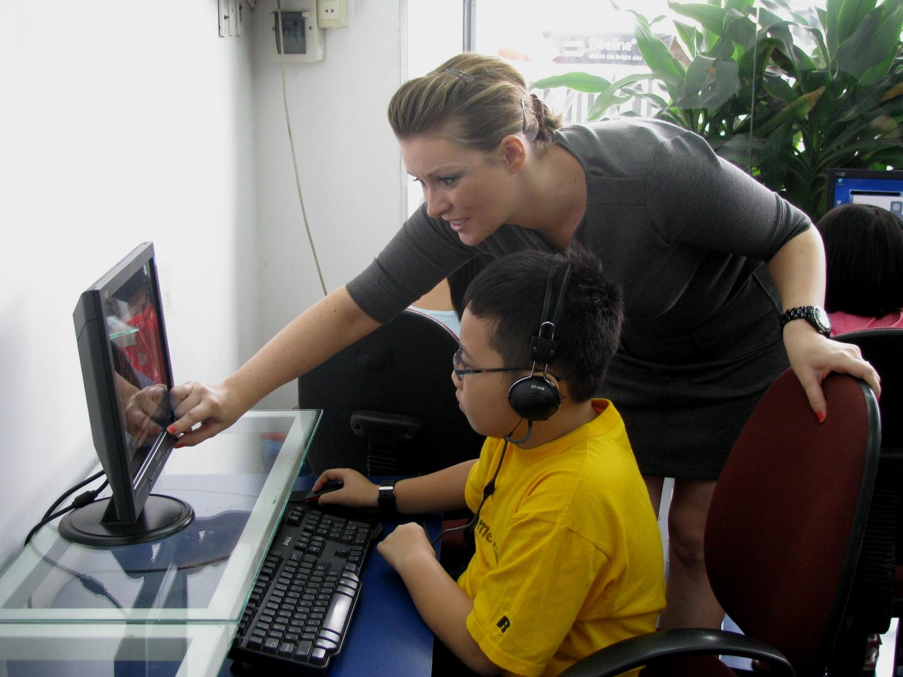
Sexual Minorities (LGBT)
Be supportive, openly discuss sexual orientation or gender identity when appropriate without portraying sexual minorities in a negative or unfavorable way.
Most LGBT students will not have family support.
Have a zero tolerance for hurtful phrases and harassment.
Create a school environment where all students can feel like they “belong”.
Notes:
Create a school environment that is supportive. Some schools are participating in gay-straight alliances (GSAs) to provide more support for sexual minority students. Let’s look at another minority group. Students with disabilities.

Slide 14
Identity and Disability
Common societal stereotypes:
menace and burden, objects of charity and pity
SHIFTING THE PERSPECTIVE
“Rather than placing emphasis on fixing or curing the person, new perspectives on disability involve efforts to modify the environment to provide more effective supports, enabling the person to succeed despite their limitations” (p.129).

Slide 15

Identity and Disability
“How students think about or define themselves is critical to the development of a positive self-identity” (p.130).
OTHER FACTORS FOR A POSITIVE SELF-IMAGE:
Quality of interpersonal relationships
Sense of well-being
School environment
Control over environment and decisions/choices
Notes:
Shifting the perspective to success is important for creating a positive self-identity.

Slide 16
Identity and Disability
What can teachers do?
Teach students the skills and knowledge they will need to become self-determined.
set personal goals
solve problems that act as barriers to these goals
make appropriate choices based on personal preferences and interests
participate in decisions that influence the quality of their lives
advocate for themselves
create action plans to achieve goals
self-regulate and self-manage day-to-day actions

Slide 17
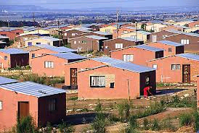
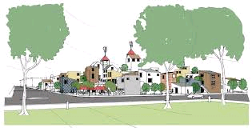

Identity and Social Class
“There is not a conscientious educator in the United States who would not want poor children to succeed in school in the hopes that their achievement might allow them to move out of poverty. The irony, however, is that America is a country deeply divided by class and, apparently, is becoming more so all the time.” (p.117).
Notes:
Suburbs vs subsidized housing. Under/unemployed underpaid surplus working class (difficult to move up regardless of aspirations or efforts (children predicted or left at “at-risk’ status of next generation. Subject matter related to working class not part of formal school curriculum. Stereotypes, lack of understanding or awareness

Slide 18
Identity and Social Class
What can educators do?
“Become powerful advocates for all of our nation’s children and be vocal about the ways social-class divisions make it difficult for them to educate all children to high standards.” (p.120).
“American education is often seen as a “great equalizer” but this mission is difficult if not impossible to accomplish as long as children continue to attend school and live their daily lives under such unequal circumstances.” (p.120).
Notes:
Affluent monopolize (p. 108) Social class issues permeate adolescents stories about school (p. 114) Academic imposters. Tracking (p.116) Subject matter not related to working class. (p.119) Great equalizer = unequal circumstances. (p. 120)

Slide 19

Beyond Categories
The Complex Identities of Adolescents
“The great task of adolescence is learning to express one’s multiple identities in personally meaningful and socially acceptable ways.
Race
Ethnicity
Social Class
Language
Gender
Sexual Orientation
Adoptees
Notes:
educators need to understand implications of adolescent identity formation for schooling. i.e. how is it affirmed or dismissed in school settings? Changes in identities are more than individ preferences and experiences; not simply psychological transformations in own head, also change in response to sociopolitical contexts in which people live, identities shaped and influenced by people interaction and material and social conditions of our lives.. Adolescence need to feel a sense of belonging and free to explore who they are.

Slide 20
Beyond Categories
The Complex Identities of Adolescents
Cultural Chameleons: “Those who manage their lives through the combination, merging, or shifting of different cultural strategies.” (p.147).
“Given the pressures to assimilate to both peer culture and, in some cases, a new national culture and society, it should come as no surprise that students develop unpredictable identifications.” (p.147).
“Adapting to a new culture often means that young people need “to abandon the fullness of their human identities as part of the process of becoming and being American.” (p.147)
Notes:
layers of identity. think of who not what they are. human impulse to categorize/label, culture as a verb rather than a noun (p146) Both/and replaces either/or from earlier era (p149).

Slide 21
Beyond Categories
The Complex Identities of Adolescents
What can educators do?
Provide a safe space for free exploration of adolescent identities in schools
Opportunities for peer association
Respectful school climates
Discuss and reflect in preservice education and inservice professional development issues of identity and diversity
Use diverse curricula to reflect realities of nontraditional families
Reflect on own ideas about race, ethnicity, sexual orientation, and other differences
“It is imperative that all educators understand how race, gender, and other differences matter in school.” (p. 159)

Slide 22
Beyond Categories
“When we think of culture and social identity in more fluid terms...we can find a foundation for educational practice that is transformative.” (Frederick Erickson, p.160)
Envision multicultural school communities as “cultures of commitment” united by a common purpose.
Listen to Students
Make no excuses, but ask a lot of questions
Be willing to take risks
Rethink the curriculum
Challenge yourself and your assumptions
Offer diverse opportunities for students to succeed
Reflection, Understanding, Action

Slide 23
References
Erikson, Erik H.1968. Identity: Youth and Crisis. New York: W. W. Norton.
Massachusetts Department of Education. 2001. Massachusetts Youth Risk Behaviour Survey (MYRB). Retrieved from www. doe.mass.edu/hsss/yrbs/01/results.pdf.
Sadowski, Michael. 2006. Adolescents at School: Perspectives on Youth, Identity, and Education. Cambridge, MA: Harvard Education Press.

